Slide 1

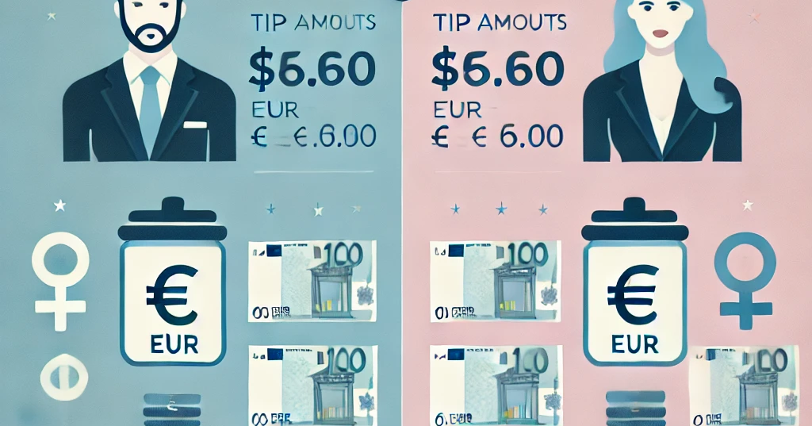

Statistical analysis of tips given by female and male

Slide 2
Dataset
Dataset- only one data table with 244 rows
Variables: total bil, tip, smoker, sex, day, time, size
Analysed two group : - Group_male 157 rows
- Group_female 87 rows

Slide 3

Descriptive statistics
 | total_bill | tip | sex | smoker | day | time | size | tip%
count | 244 | 244 | 244 | 244 | 244 | 244 | 244 | 244
unique | NaN | NaN | 2 | 2 | 4 | 2 | NaN | NaN
top | NaN | NaN | Male | No | Sat | Dinner | NaN | NaN
freq | NaN | NaN | 157 | 151 | 87 | 176 | NaN | NaN
mean | 19.785943 | 2.998279 | NaN | NaN | NaN | NaN | 2.569672 | 0.160803
std | 8.902412 | 1.383638 | NaN | NaN | NaN | NaN | 0.951100 | 0.061072
min | 3.070000 | 1.000000 | NaN | NaN | NaN | NaN | 1.000000 | 0.035638
25% | 13.347500 | 2.000000 | NaN | NaN | NaN | NaN | 2.000000 | 0.129127
50% | 17.795000 | 2.900000 | NaN | NaN | NaN | NaN | 2.000000 | 0.154770
75% | 24.127500 | 3.562500 | NaN | NaN | NaN | NaN | 3.000000 | 0.191475
max | 50.810000 | 10.000000 | NaN | NaN | NaN | NaN | 6.000000 | 0.710345

Slide 4
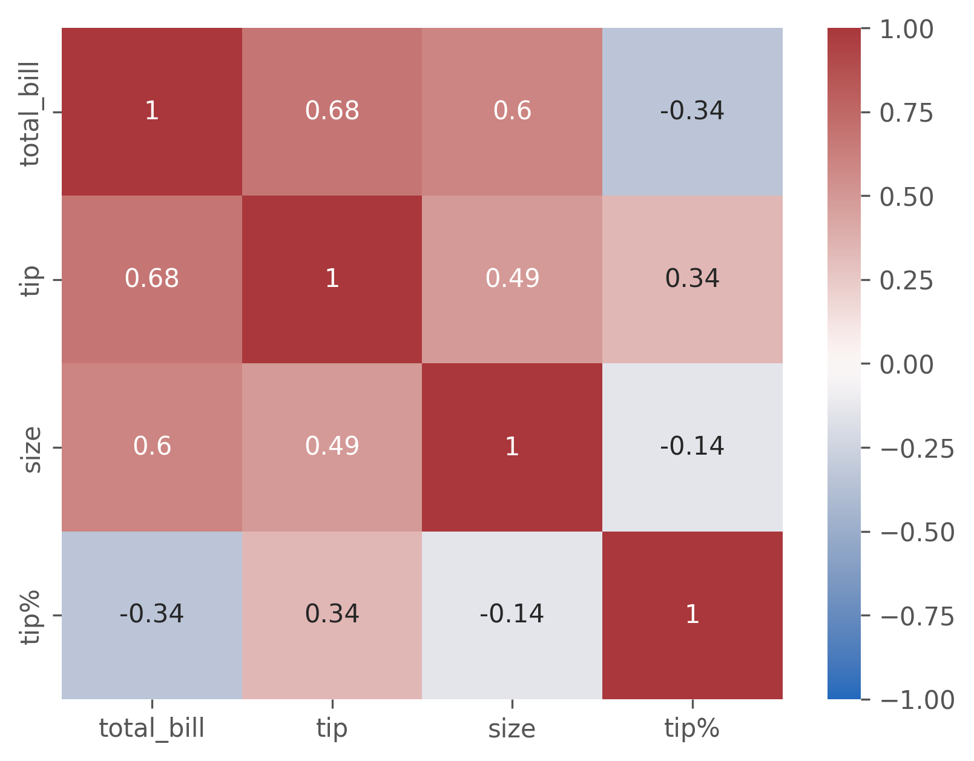
Correlation in heatmap

Slide 5
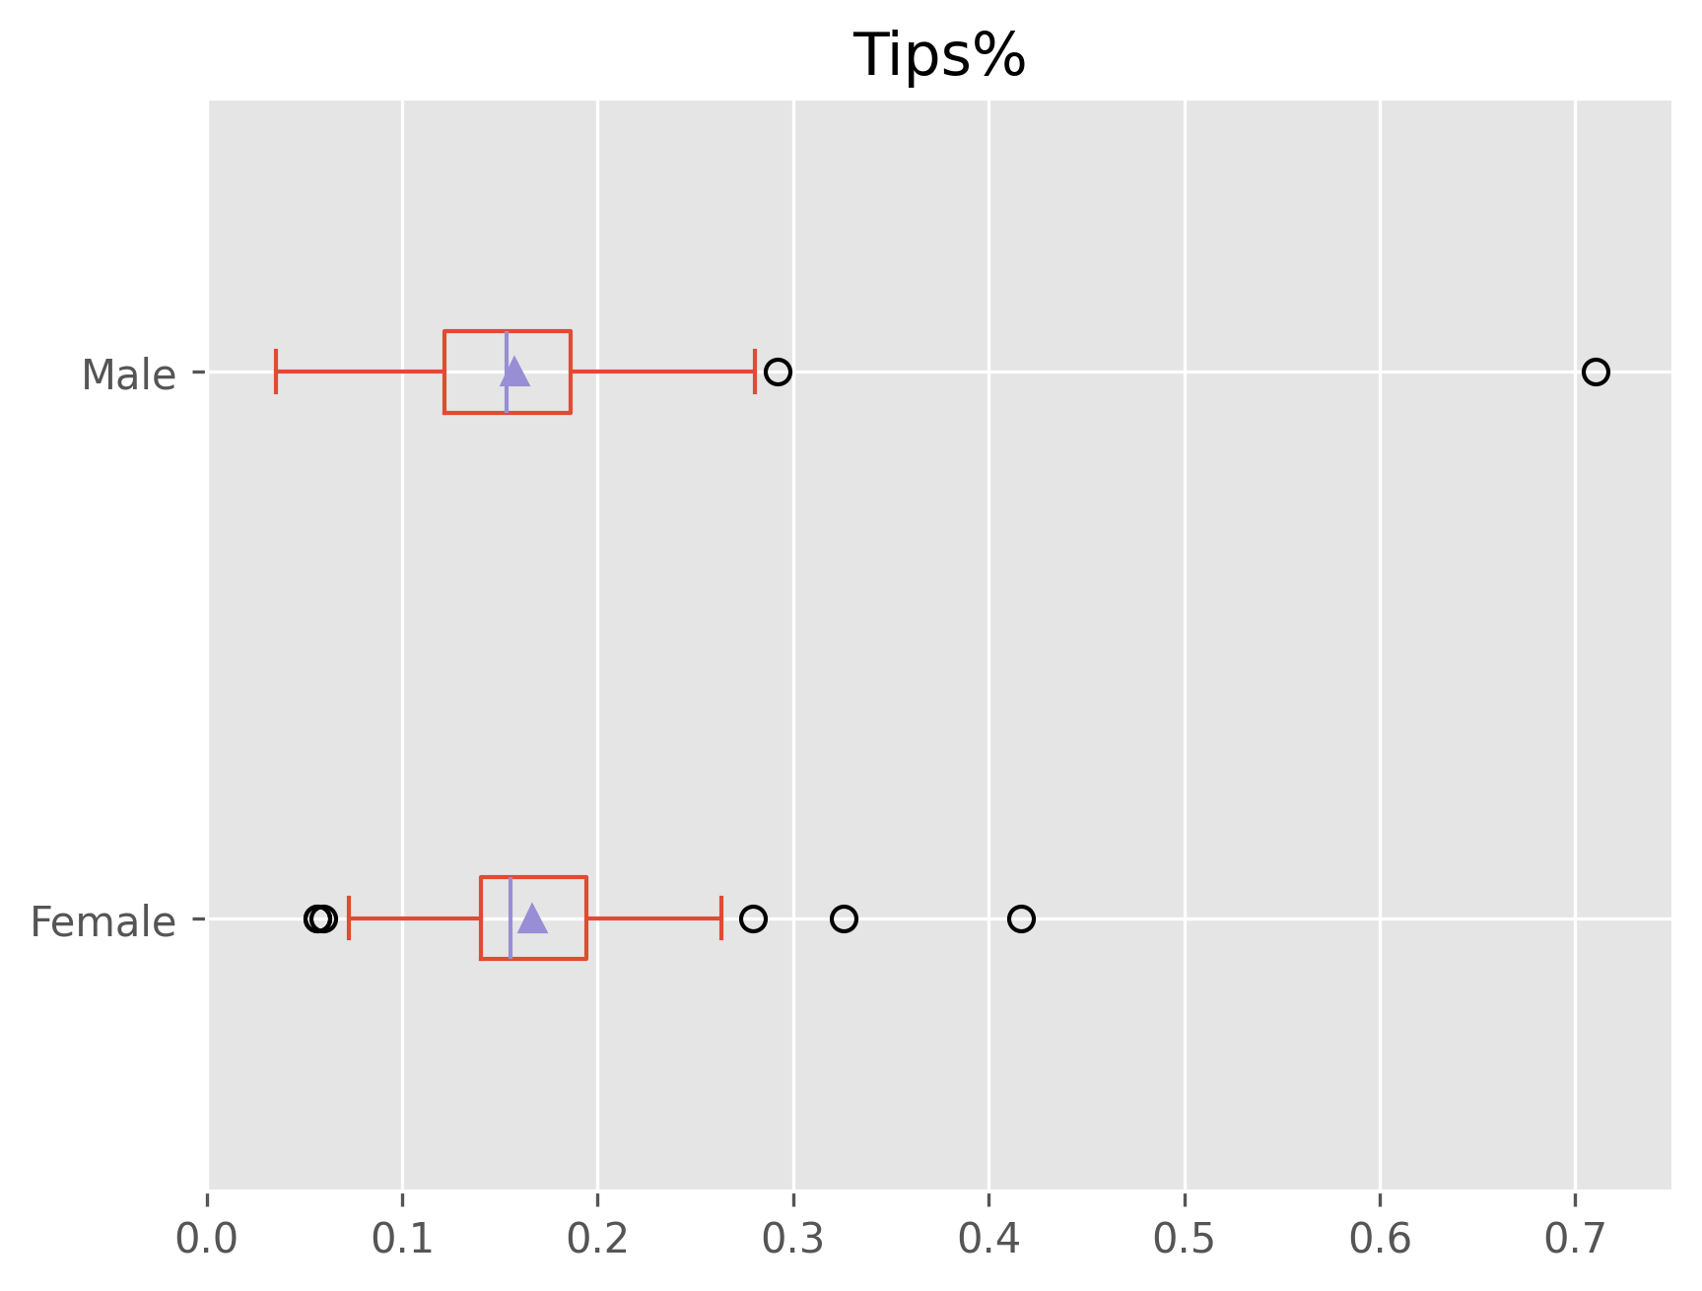
Box plot for tips% given by female and male

Slide 6
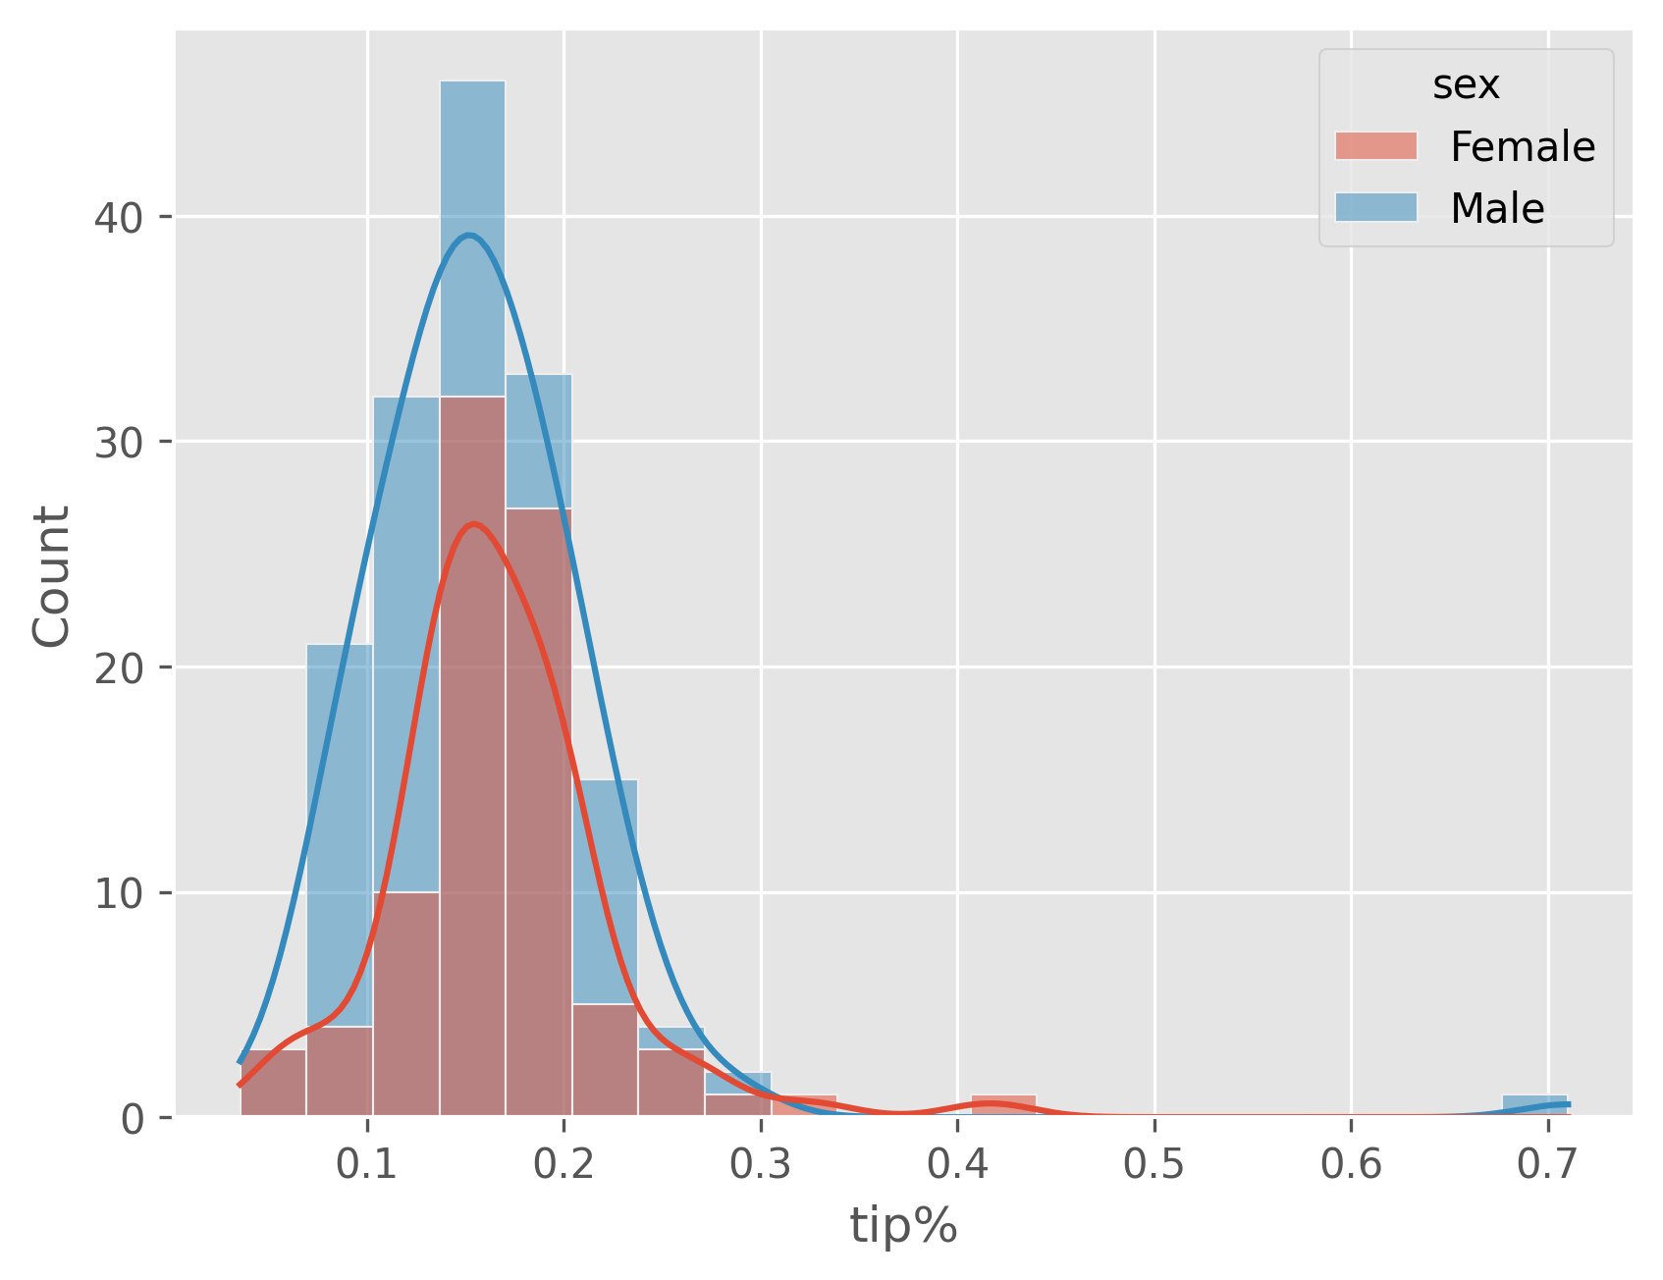
Right-skewed skew_male= 3,99 skew_female = 1,31
Leptokurtosis
Kurtosis_male = 31,98
Kurtosis_female = 5,05

Slide 7
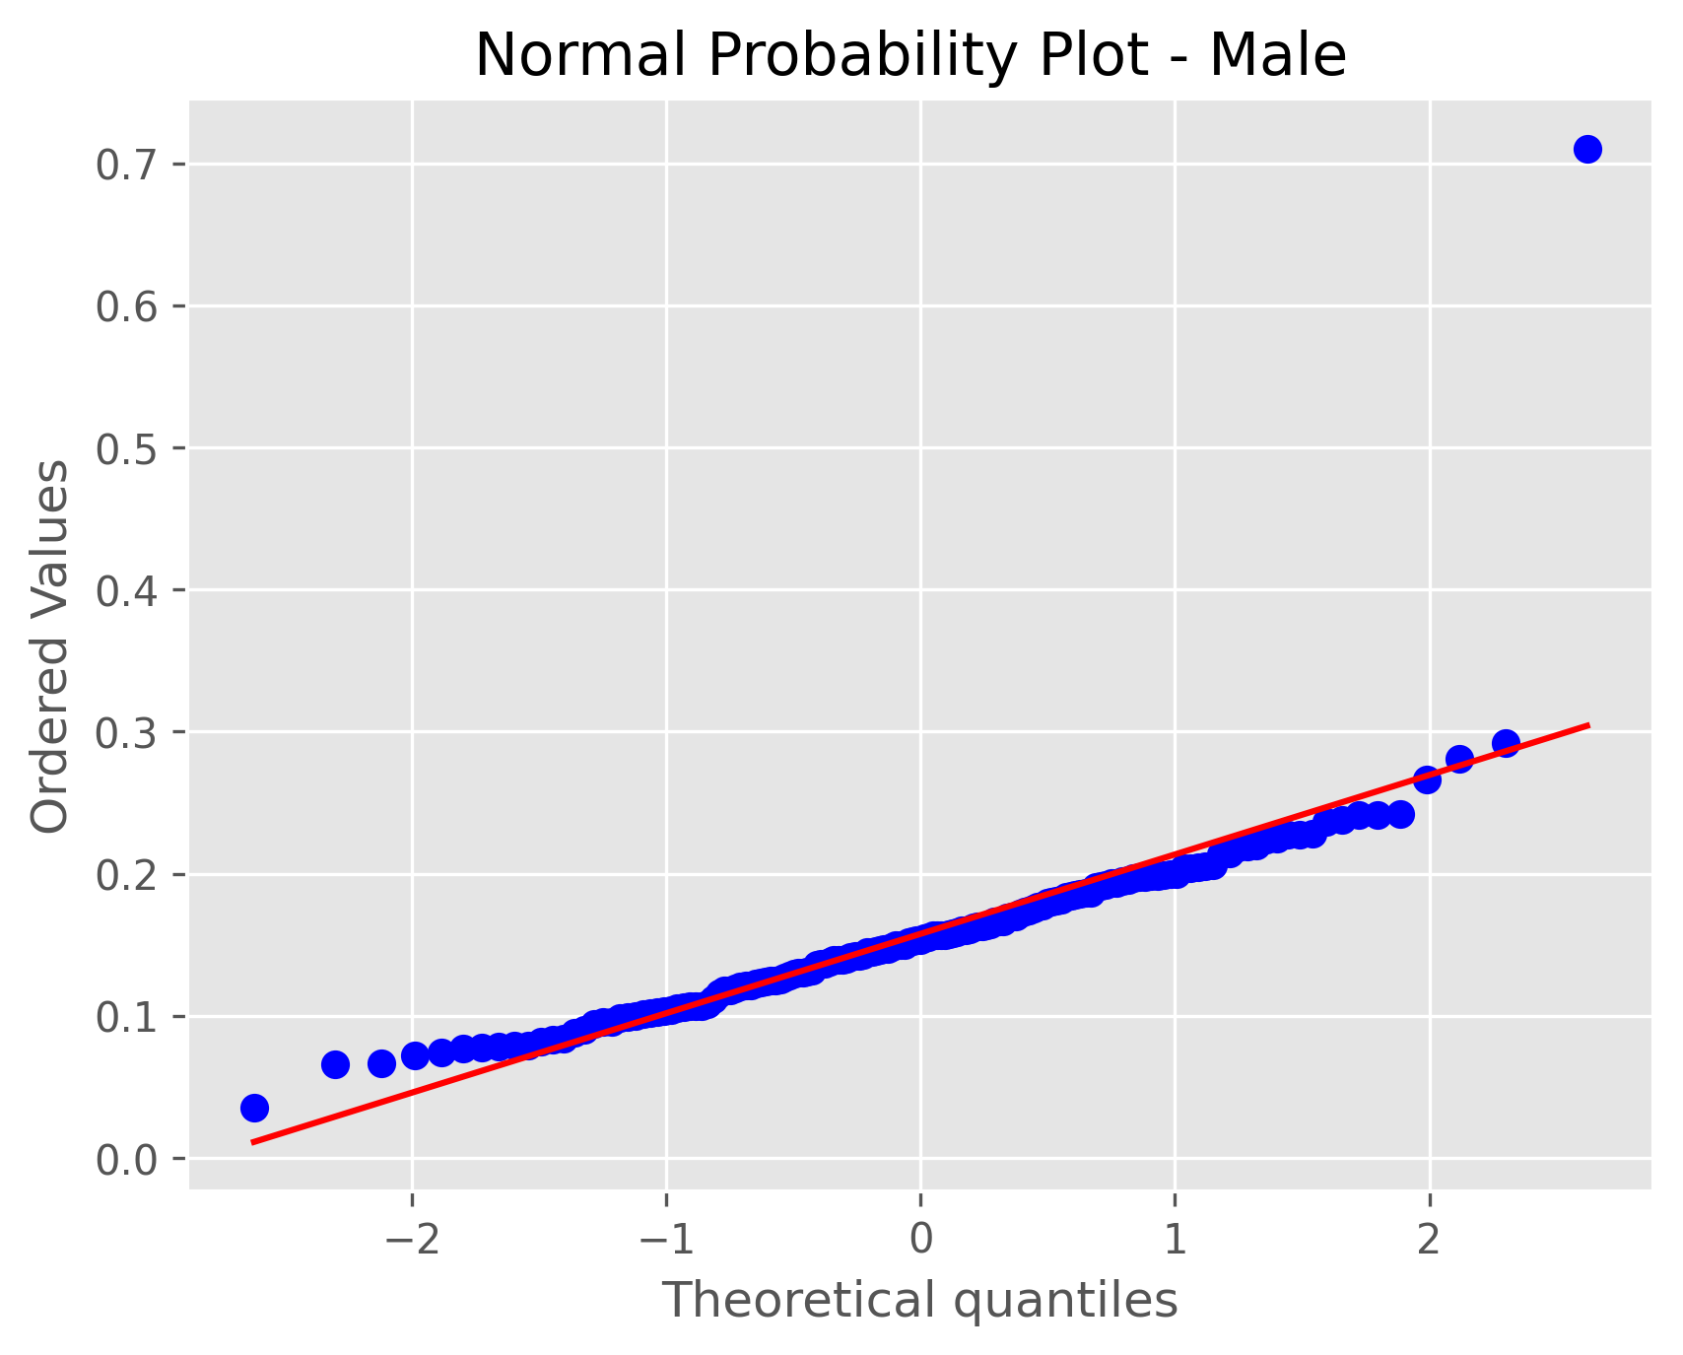
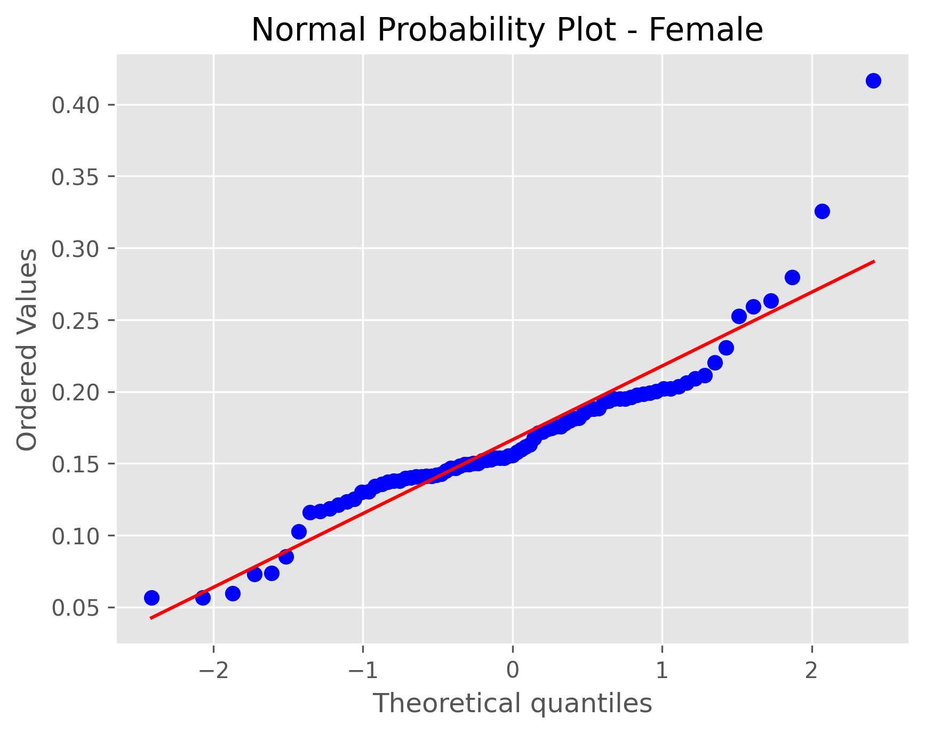
Sample groups are significantly DIFFERENT from a normal distribution according to Shapiro-Wilk normality test (p=0,00)

Slide 8
There is NO significant DIFFERENCE in the two sample groups
Levene's test p = 0,4986
Student's t-test p = 0,2797

